Slide 1
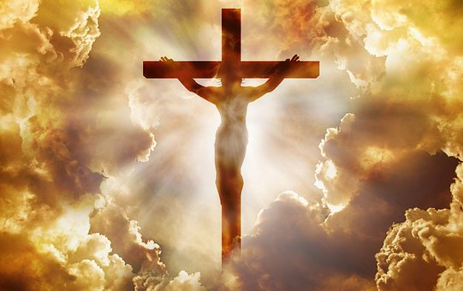
不再是我乃是基督
No Longer I But Christ
天路诗歌第二集
加2:20, 林后5:17

Slide 2
不再是我不再是我
是主在我里面活
不再是我不再是我
是主在我里面活
I no longer, no longer live
It's the Lord who lives in me
I no longer, no longer live
It's the Lord who lives in me
不再是我1/4

Slide 3
乃是基督乃是基督
基督在我里面活
乃是基督乃是基督
基督在我里面活
It is Christ, it is Christ
But Christ lives in me.
It is Christ, it is Christ
But Christ lives in me
不再是我2/4

Slide 4
脱去旧人脱去旧人
在基督里是新造的人
穿上新人穿上新人
我已是新造的人
Take off old self, the old has gone
In Christ a new creation has come
Put on the new, cloth on the new
I'm a new creation in Christ
不再是我3/4

Slide 5
就我而论就我而论
世界已钉在十架上
就世界沦就世界论
我已钉在十架上
As far as I am concerned
The world has been nailed to the Cross
In this world In this world
I’ve been crucified with Christ
不再是我4/4

Slide 6
我已经与基督同钉十字架
现在活着的不再是我
不再是我乃是基督
基督在我里面活
I’ve been crucified with Christ.
Now I no longer live
No longer me but Christ
Christ lives in me
不再是我 Chorus

Slide 7
我已经与基督同钉十字架
现在活着的不再是我
不再是我乃是基督
基督在我里面
里面里面里面里面活
I’ve been crucified with Christ.
Now I no longer live
No longer me but Christ
Christ lives inside of me
Inside inside inside inside of me
不再是我Chorus’
End

